Slide 1


MACHINE LEARNING
Mohamad Irwan Afandi

Slide 2

What is Machine Learning ?
Machine Learning is about making machines get better at some task by learning from data, instead of having to explicitly code rules.
How do we know that the system is working properly? Test the system with the data that you didn’t use in training process, and see the accuracy.
Machine Learning Example:
Email Spam Detection
Customer Segmentation
Fraud Detection
Self Driving Car
Image Recognition, etc.

Slide 3
Type of Machine Learning
There are 4 types of machine learning:
Supervised Learning (data with label)
Unsupervised Learning (data without label)
Semi-supervised Learning (data with label + without label)
Reinforcement Learning (using reward)
Solve the problem in supervised learning:
Classification : process of predicting class or category from observed values, the result is categorical data.
Regression : is to predict output labels or responses which are continues numeric values.

Slide 4


Classification vs Regression
Classification : predict the categorical value like yes or no, class A or class B, etc.
Regression : Get the continue value from the data (dependent variable) based on another data (independent). Like salary or price
Main Problem
Underfitting is the case where the model has not learned enough from the training data, resulting in low generalization and unreliable predictions. Factors: we have lass data, build a linear modal with non linear data. Solution add more dataset.
Overfitting is the case where the model fits too well to the training set. Overfitting occurs if the model or algorithm shows low bias but high variance. Solution split and test data or using cross-validation.

Slide 5


Slide 6
machine Algorithm
Supervised Learning
Classification
Logistic Regression
K Nearest Neighbors (KNN)
Support Vector Machine (SVM)
Naïve Bayes (NB)
Decision Tree Classification
Random Forest Classification
Neural Networks
Regression
Simple Linear Regression
Support Vector Regression
Decision Tree Regression
Random Forest Regression
Neural Networks
Unsupervised Learning
K-Means, C-means, Fuzzy
Hierarchical
Gaussian Mixture
Hidden Markov Model
Neural Networks

Slide 7
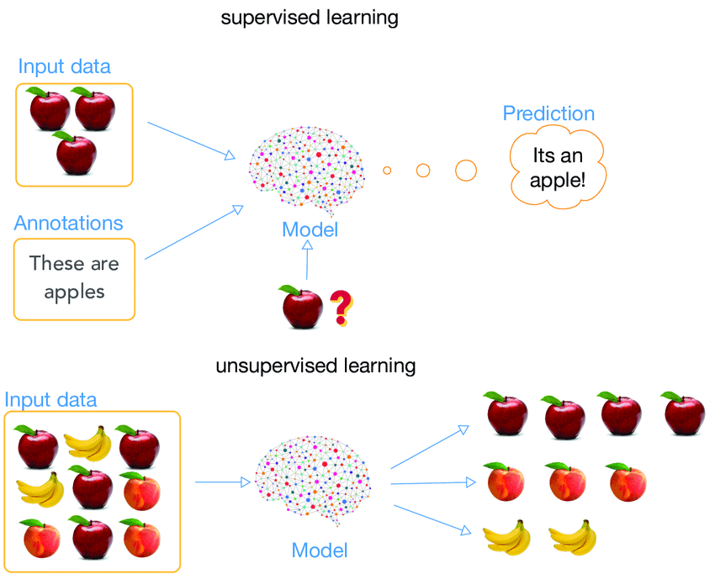
How it
Works..?
Grouped the data

Slide 8
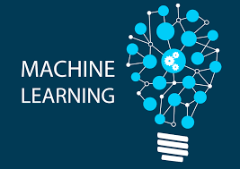
Build Machine Learning Model
Import necessary python package
Load the dataset
Preprocessing and EDA
Organizing data into training and test sets (only on supervised)
Build machine learning model
Evaluate the model
Machine Learning
Details >>

Slide 9
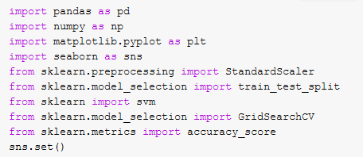
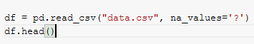
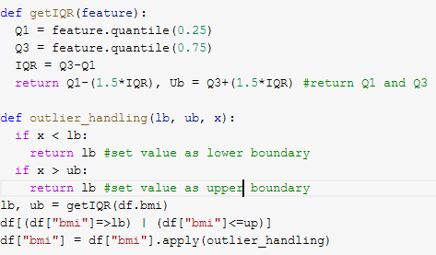
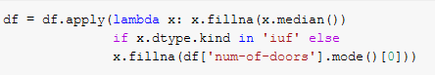
Build Machine Learning Model
1
Import Necessary Python Package
2
Load the Dataset
Most of programmer puts it (all import code) at the beginning section
You can load dataset from csv, xlxs, txt, html, json, etc.
Outlier Handling
3
Preprocessing and EDA
Generally you will dealing with missing value, data anomalies, outlier, imbalance data, scaling, visualization, etc.
Missing value handling

Slide 10
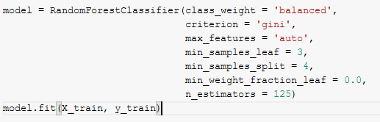
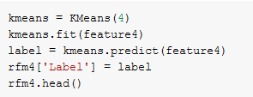
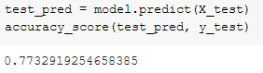
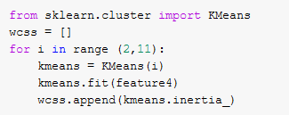
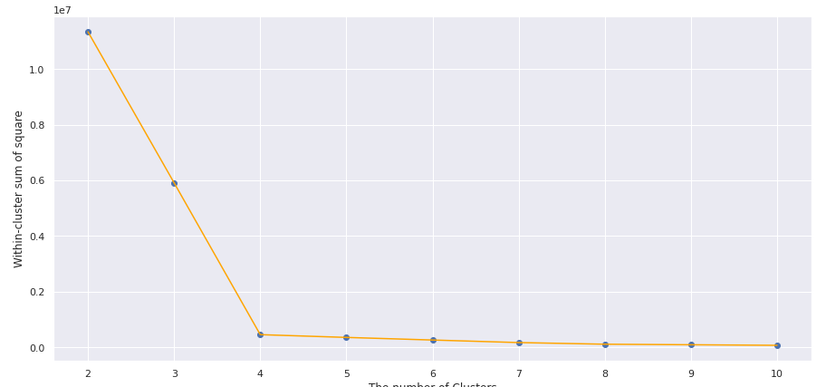
Build Machine Learning Model
4
Organizing the data into training and test sets
To avoid overfitting and know the accuracy score (only on supervised)
5
Build a model
Use hyperparameter tuning to get the best parameter (only on supervised)
Supervised
Unsupervised
6
Evaluate the model
If the accuracy is good enough you can deploy, if isn’t enough back to preprocessing or try another mode
Choose the
best K

Slide 11

SUPERVISED LEARNING

Slide 12
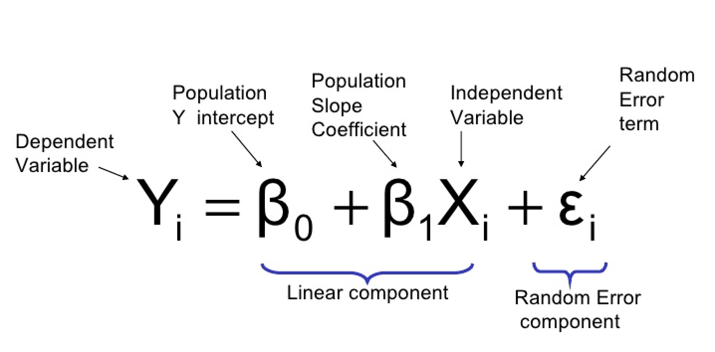
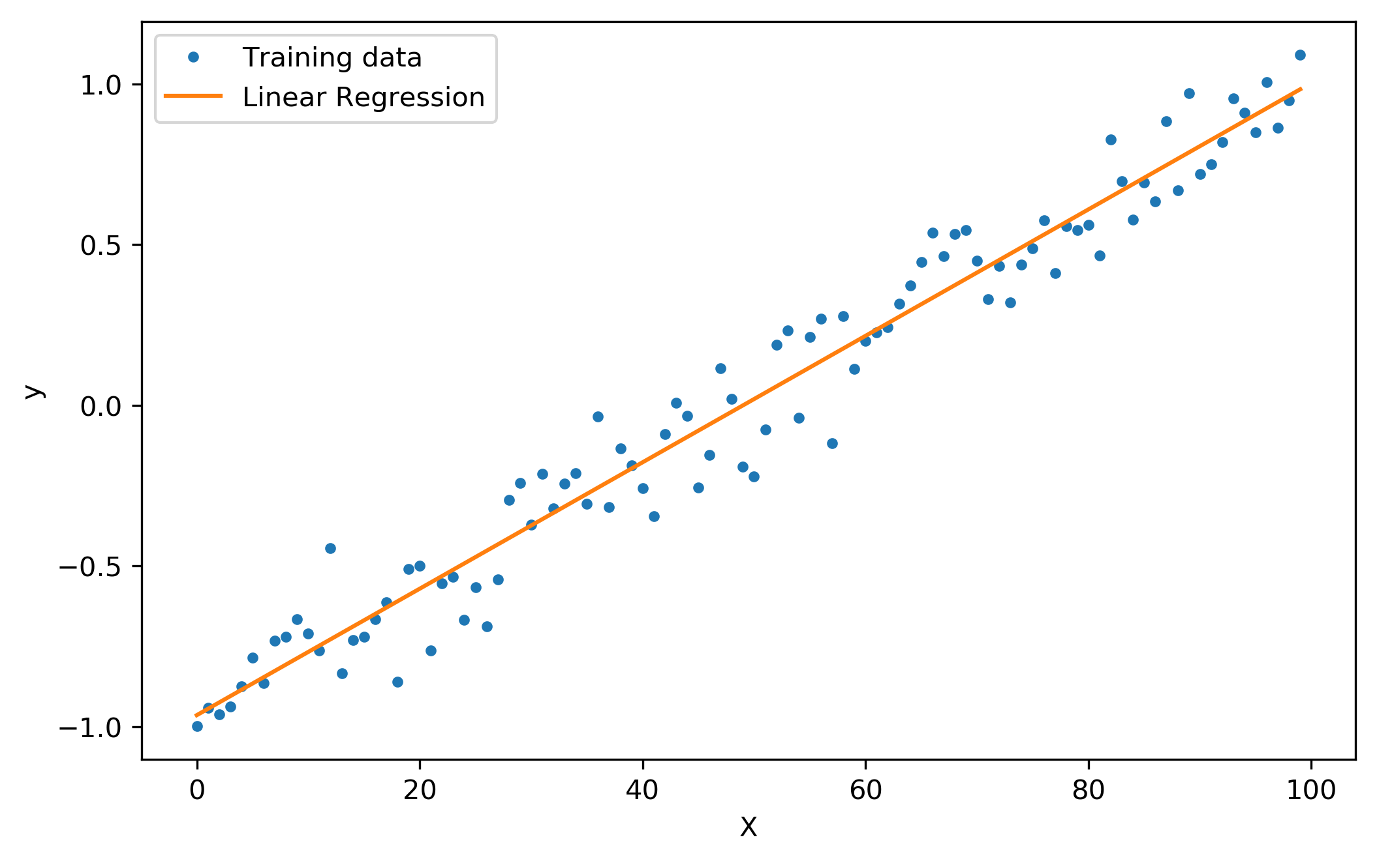
1
Simple Linear Regression
Regression
Simple Linear regression attempts to model the relationship between two variables by fitting a linear equation to observed data. One variable is considered to be an explanatory variable (independent), and the other is considered to be a dependent variable.
Dependent : it is something that depends on other factors.
Independent : is the variable the experimenter changes or controls and is assumed to have a direct effect on the dependent variable.
implementation Example:
House Price Prediction
Salary Prediction

Slide 13
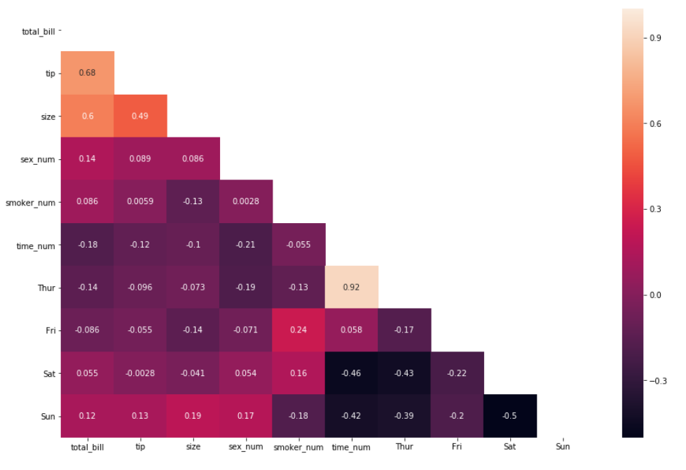
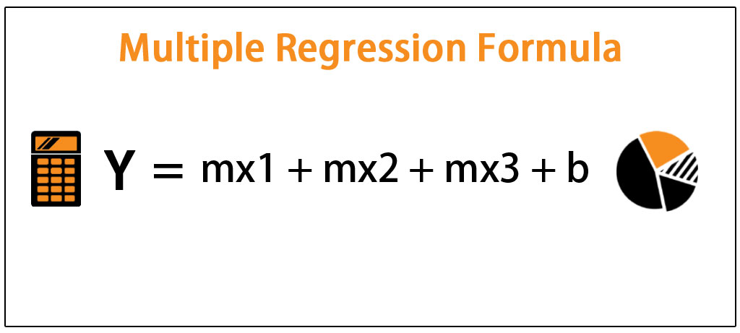
2
Multivariate Regression
Regression
Multivariate Regression is supervised machine learning algorithm involving multiple data variables for analysis. A Multivariate regression is an extension of multiple regression with one dependent variable and multiple independent variables. Based on the number of independent variables, we try to predict the output. After get the values use hit map to see the data correlation.
Heat map correlation
implementation Example:
How much Company has to pay to a new hire
Predict the total crop yield expected
Predict the GDP growth

Slide 14

3
Logistic Regression
Classification
Logistic regression is a supervised learning classification algorithm used to predict category of the variable based on the probability of a target variable. The nature of target or dependent variable is dichotomous, which means there would be only two possible classes. Type of logistic regression: binary (0 or 1), categorical (more than 2 : A, B and C), and ordinal (ordered value more than 2: easy, medium, expert)
If the logit value is not 0 or 1, see the probability because we can define the class based on it. If the probability less then 0.5 it will classified to 0 and more than equal to 0.5 will classified to 1 (default library)
0.5 <= x , x = 1
x > 0.5, x = 0
implementation Example:
Email Spam Detection
Online transaction for Fraud detection

Slide 15
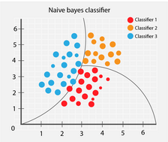
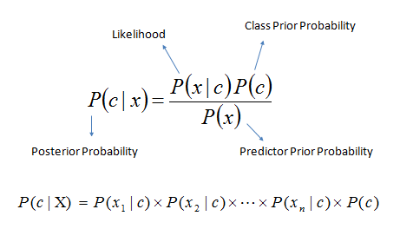
4
Naïve Bayes
Classification
Naïve Bayes (using baye’s theorem) is that the presence of a feature in a class is independent to the presence of any other feature in the same class. For example, a phone may be considered as smart if it is having touch screen, internet facility, good camera etc. Though all these features are dependent on each other, they contribute independently to the probability of that the phone is a smart phone.
The likelihood that an event (c) will happen given that another event (x) has already happened
Implementation Example:
Recommendation System
Text Classification
Multiclass prediction

Slide 16
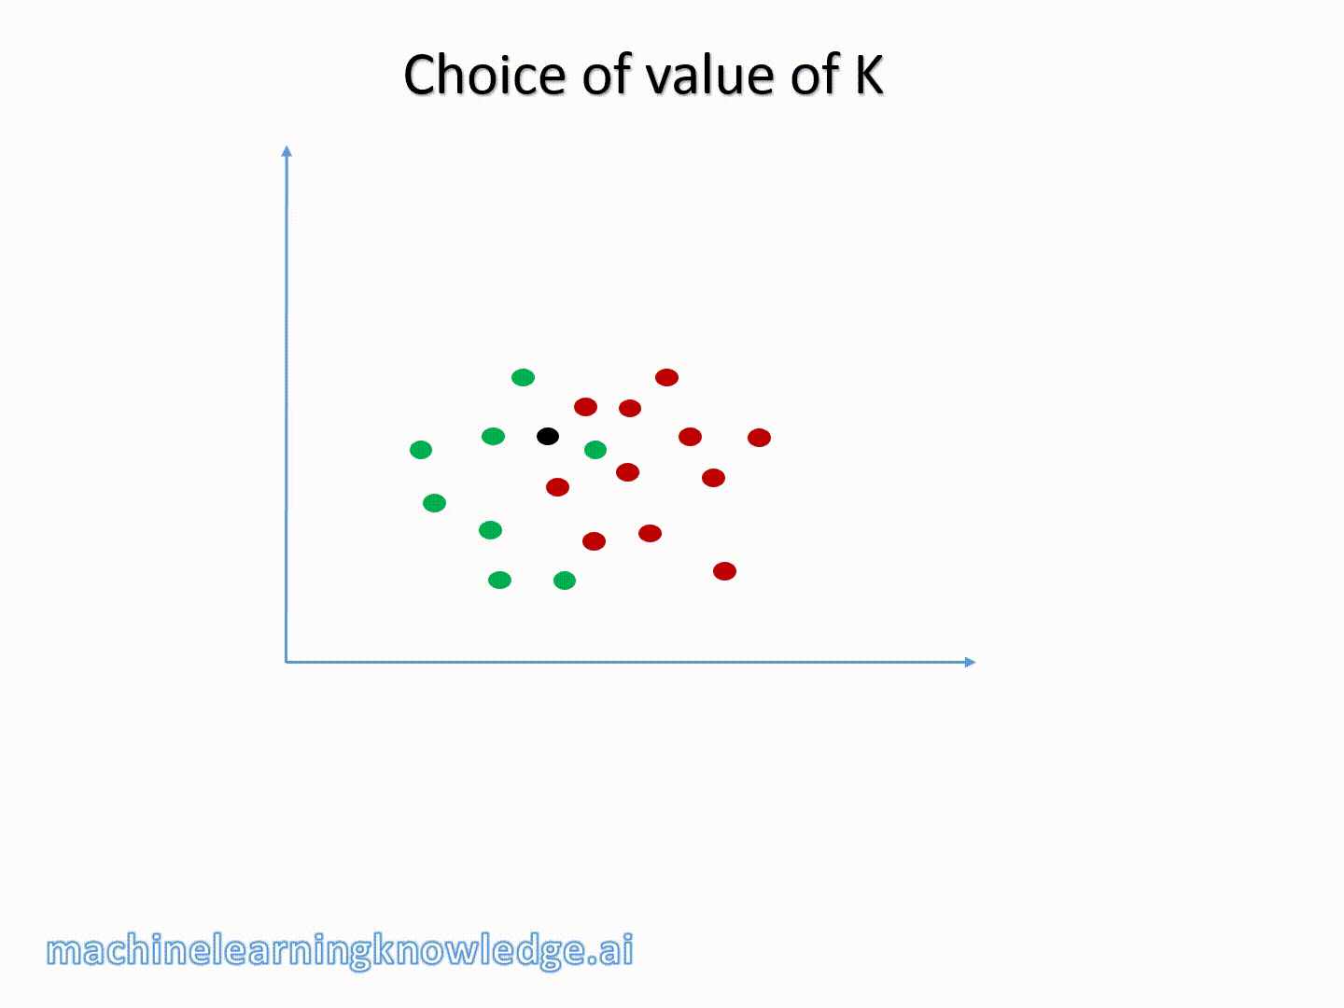
5
K Nearest Neighbour
Classification & Regression
KNN works by finding the distances between a query and all the examples in the data, selecting the specified number examples (K) closest to the query, then votes for the most frequent label (in the case of classification) or averages the labels (in the case of regression).
Advantages:
Quick calculation time and simple
Versatile (regression and classification)
High Accuracy
Disadvantages:
Accuracy depends on the quality of the data
With large data, the prediction stage might be slow
implementation Example:
predict the credit rating of customers
predict whether the loan is safe or risky (banking)
classifying potential voters in two classes will vote or won’t vote (political)

Slide 17
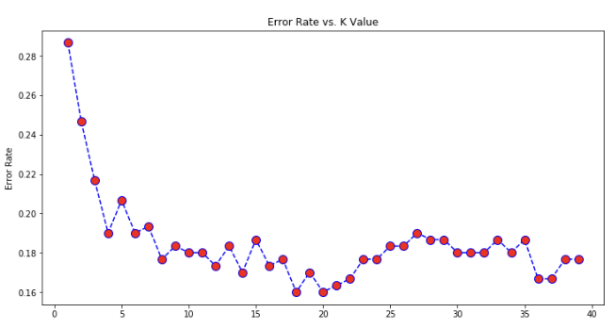
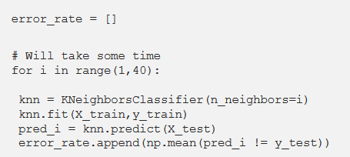
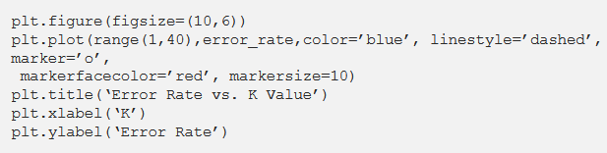
5
K Nearest Neighbour
Classification & Regression
Choose the best number of K using Elbow method
Get the error rate for every K
Get the error rate for every K

Slide 18
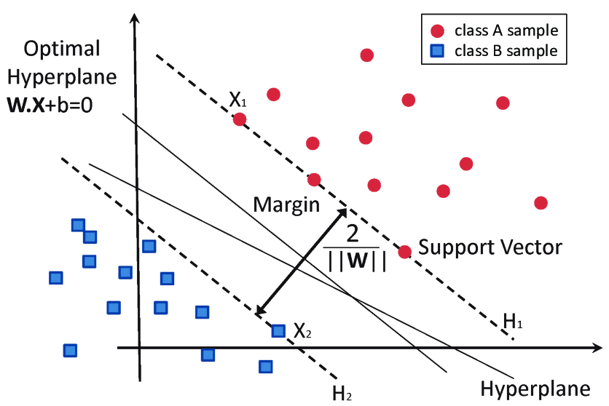
6
Support Vector Machine
Classification & Regression
SVM model is basically a representation of different classes in a hyperplane in multidimensional space. The goal of SVM is to divide the datasets into classes to find a maximum marginal hyperplane (MMH).
Advantages:
works well when there is clear margin of separation between classes.
more effective in high dimensional spaces.
Memory efficient
Disadvantages:
not suitable for large data.
does not perform very well, when the data set has more noise
implementation Example:
Sentiment Analysis
Image Classification

Slide 19
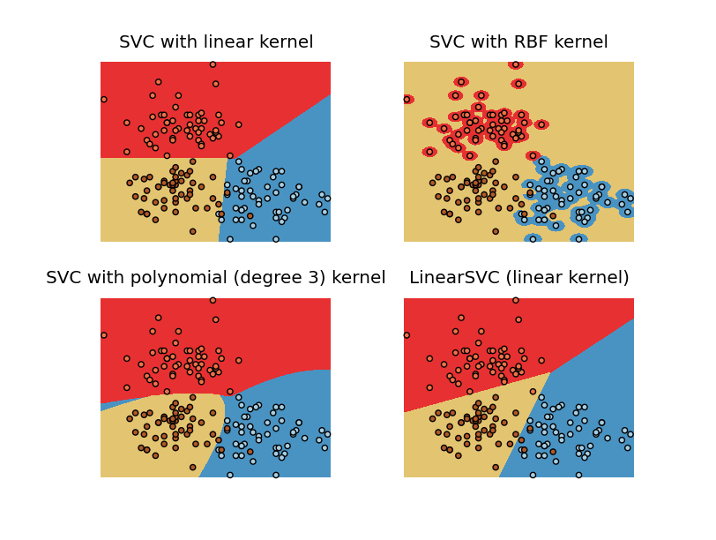
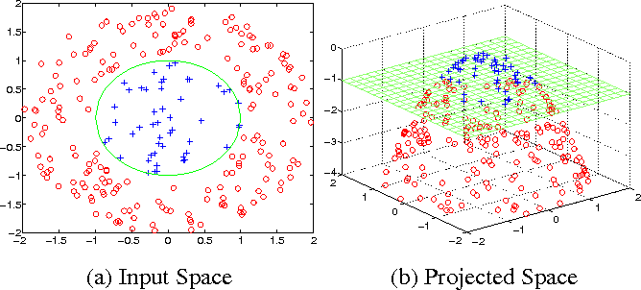
6
Support Vector Machine
Classification & Regression
SVM Kernel Trick usually use to choose the right hyperplane for separate the data. You have to know that the class data distribution cannot be separated only by linear line. SVM Kernel : Linear, Radial Basis Function (RBF), Sigmoid, Polynomial.

Slide 20
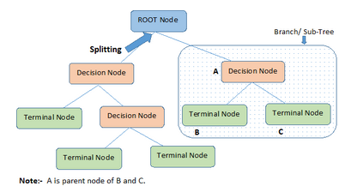
7
Decision Tree
Classification & Regression
A decision tree is a flowchart-like structure in which each internal node represents a test on a feature (e.g. whether a coin flip comes up heads or tails) , each leaf node represents a class label (decision taken after computing all features) and branches represent conjunctions of features that lead to those class labels and the paths from root to leaf represent classification rules.
Advantages:
Easy to Understand
Less data cleaning required
Data type is not a constraint (handle both numerical and categorical variable)
Disadvantages:
Over fitting
Not fit for continuous variables

Slide 21
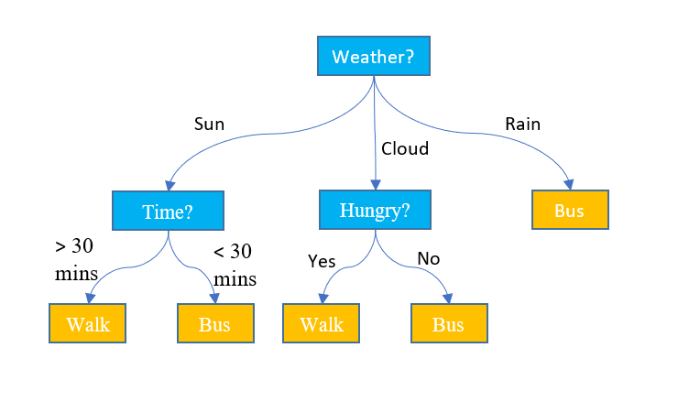
7
Decision Tree
Classification & Regression
Determine what will we do to back home
No
Yes

Slide 22
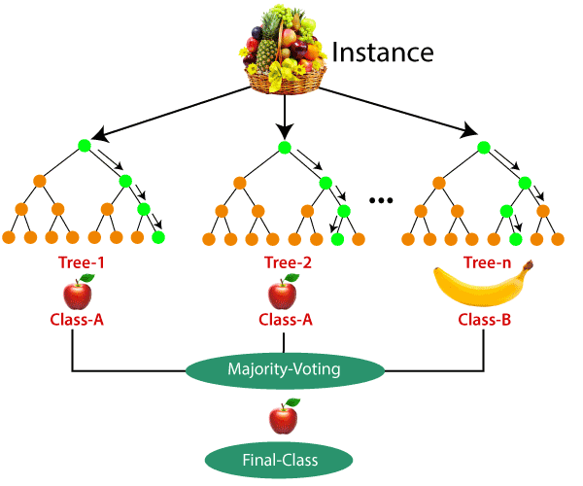
8
Random Forest
Classification & Regression
Random forest, like its name implies, consists of a large number of individual decision trees that operate as an ensemble. Each individual tree in the random forest spits out a class prediction and the class with the most votes becomes our model’s prediction.
Advantages:
It reduces overfitting problem in decision trees and also reduces the variance
Random Forest can automatically handle missing values.
Disadvantages:
High Complexity
Longer Training Period

Slide 23
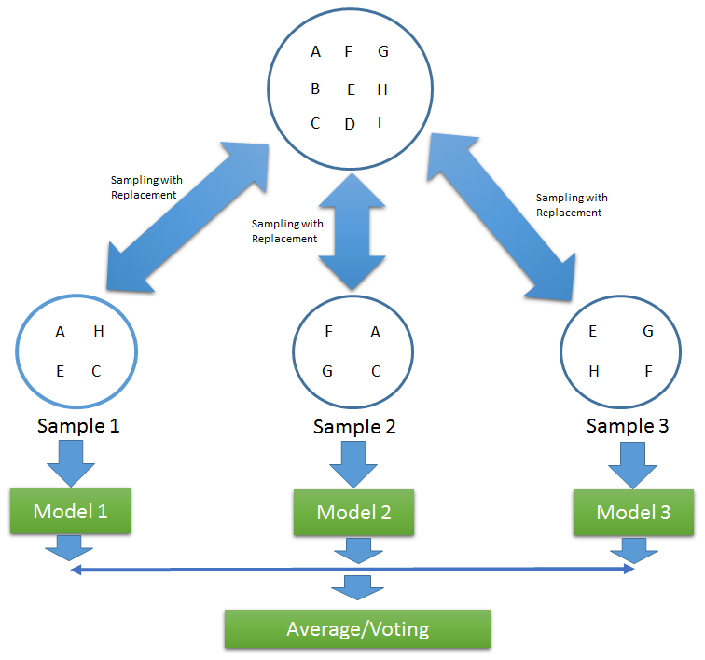
8
Random Forest
Classification & Regression
To generate the three from data training, RF using Bagging method. Bagging is an approach is to use the same training algorithm for every predictor, but to train them on different random subsets of the training set. When sampling is performed with replacement, this method is called bagging (bootstrap aggregating).

Slide 24

UNSUPERVISED LEARNING

Slide 25

1
K-Means
Clustering
K-means is a centroid-based algorithm, or a distance-based algorithm, where we calculate the distances to assign a point to a cluster. In K-Means, each cluster is associated with a centroid. With K-Means, we will grouped the data based on the nearest distance in with (x) centroid.
Advantages:
Easy to understand and implement
If we have large number of variables then, K-means would be faster than Hierarchical clustering.
Disadvantages:
It is a bit difficult to predict the number of clusters
Order of data will have strong impact on the final output.
implementation Example:
Customer Segmentation
Document Clustering
Recommendation Engineering

Slide 26
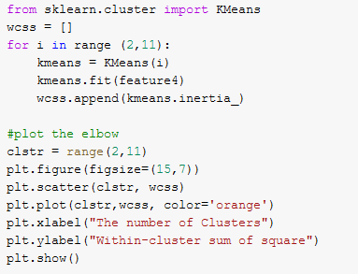
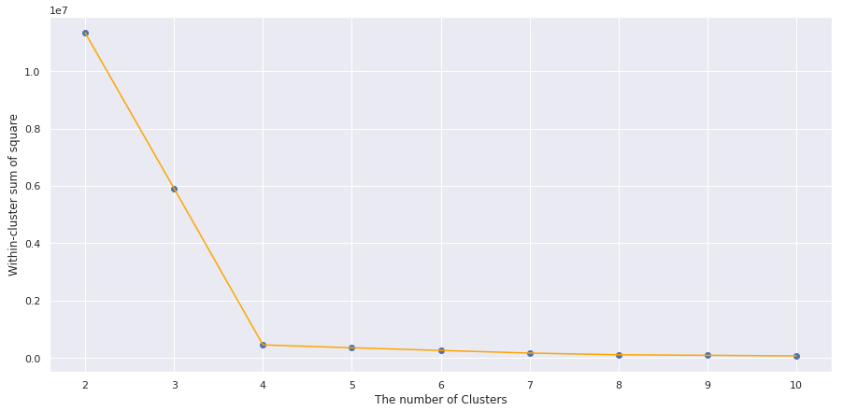
1
K-Means
Clustering
Choose the best K-centroid for our cluster using Elbow Method
inertia actually calculates the sum of distances of all the points within a cluster from the centroid of that cluster. Keeping this in mind, we can say that the lesser the inertia value, the better our clusters are.

Slide 27

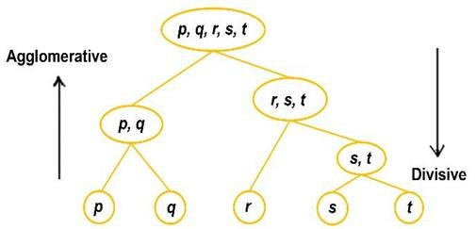
2
Hierarchical
Clustering
Hierarchical clustering is unsupervised learning that used to group together the unlabeled data points having similar characteristics. Hierarchical clustering algorithms falls into following two categories.
Agglomerative, each data point is treated as a single cluster and then successively merge or agglomerate (bottom-up approach) the pairs of clusters (dendrogram or tree structure)
Divisive, all the data points are treated as one big cluster and the process of clustering involves dividing (Top-down approach) the one big cluster into various small clusters.

Slide 28
`
Thank You
We don’t need to memorize every rows of code.
But we need to practice every day, so start loving the code.

Slide 29
References
https://www.tutorialspoint.com/machine_learning_with_python/index.htm
https://towardsdatascience.com/what-are-overfitting-and-underfitting-in-machine-learning-a96b30864690
https://www.kdnuggets.com/2018/05/general-approaches-machine-learning-process.html
https://medium.com/@moussadoumbia_90919/elbow-method-in-supervised-learning-optimal-k-value-99d425f229e7
https://www.analyticsvidhya.com/blog/2019/08/comprehensive-guide-k-means-clustering/
https://www.analyticsvidhya.com/blog/2019/05/beginners-guide-hierarchical-clustering/

